Slide 1


Sharing Data Across APIs Should be Easy
My web site has an API, your web site has an API, let’s make a mash-up!
foo.com
HTTP Request
bar.com
HTML
?
AJAX
AJAX
(from page hosted on foo.com)
JSON

Slide 2
Cross Origin Resource Sharing
Once CORS is enabled, cross-domain communication via AJAX/HTTP/JavaScript is possible
CORS
foo.com
bar.com
HTML
AJAX
AJAX
JSON
JSON

Slide 3
How does it work?
By adding HTTP headers to cross-domain HTTP requests and responses

Slide 4
What is Origin?
Origin includes the combination of protocol, domain, and port. This means https://api.mydomain.com and https://mydomain.com are actually different origins and thus impacted by same-origin policy. In a similar way, http://localhost:9000 and http://localhost:8080 are also different origins. The path or query parameters are ignored when considering the origin.

Slide 5
Simple Requests
Methods
GET
HEAD
POST
Headers ( in addition to the ones set by user agent)
Accept
Accept-Language
Content-Language
Content-Type (but note the additional requirements below)
DPR
Downlink
Save-Data
Viewport-Width
Width

Slide 6
Values for the Content-Type header are:
application/x-www-form-urlencoded
multipart/form-data
text/plain

Slide 7
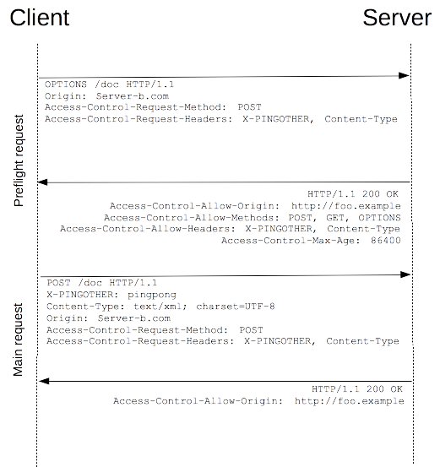

Slide 8
Access-Control-Allow-Origin: http://foo.example
Access-Control-Allow-Methods: POST, GET, OPTIONS
Access-Control-Allow-Headers: X-PINGOTHER, Content-Type
Access-Control-Max-Age: 86400

